Slide 1
Predicting the best place to life in in Germany to make an AI career
David Galve Masip
May 12, 2020

Slide 2
Intro
The explosion of AI (Artificial Intelligence), DS (Data Science) and DM (Data Mining) has a huge impact in the markets. There is more and more people likely to find out in which cities those companies are arising and clustering to find out where is a suitable place to life in which satisfies those features and where would be easy to start with such a professional career like this. And what could be more elementary than “where I am”? Let’s answer it in the coming sheets!

Slide 3
Hypothesis
Searching for information is now a days very easy though quite difficult to trust
This project aims to predict easily which city is the more appropriated to life for AI careers
Compare the results from your job search (i.e. LinkedIn, StepStone, etc) with this tool

Slide 4
Interest
Everyone starting/continuing but moving a career based on AI, DS or DM and thinking about not to transfer a lot.

Slide 5
Data acqisition
OpenMaps
Wikipedia
Foursquare

Slide 6
Data cleaning
The data is first queried and transformed to json data for later normalize it in a Pandas’ data frame
Then these Pandas’ data is filtered for company’s name, categories and location, rest is dropped
This last filter appends all sub-columns in columns for categories. This allows the developer to easily work with the data in that final Pandas’ data frame.

Slide 7
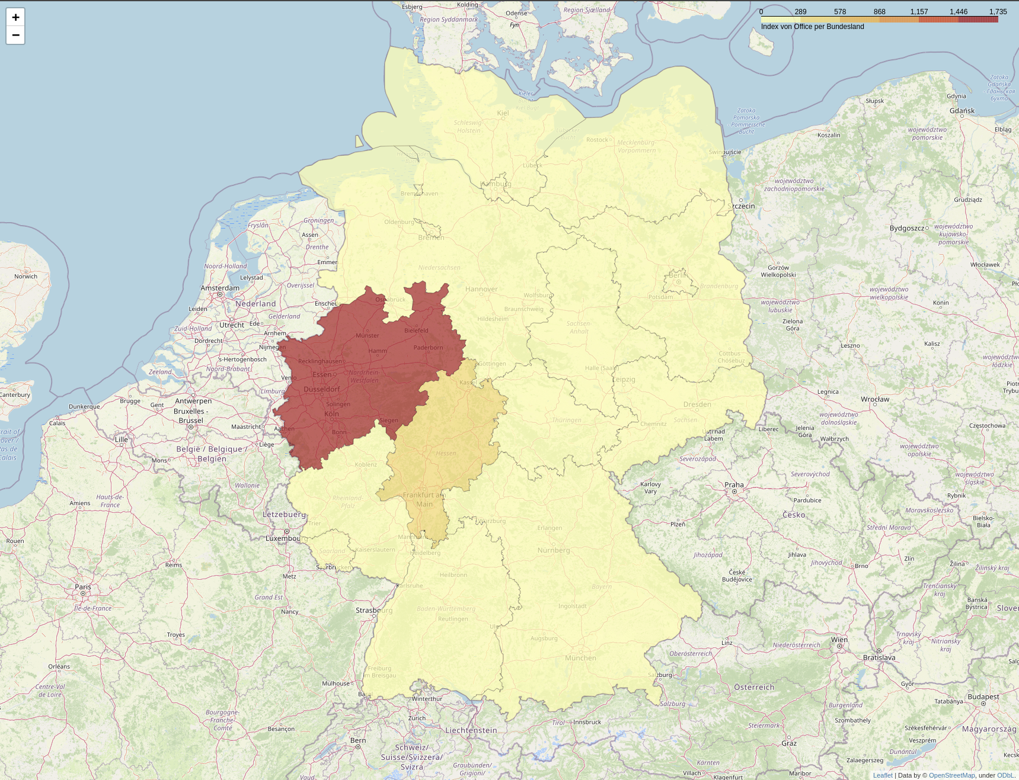
Result for amount of businesses

Slide 8
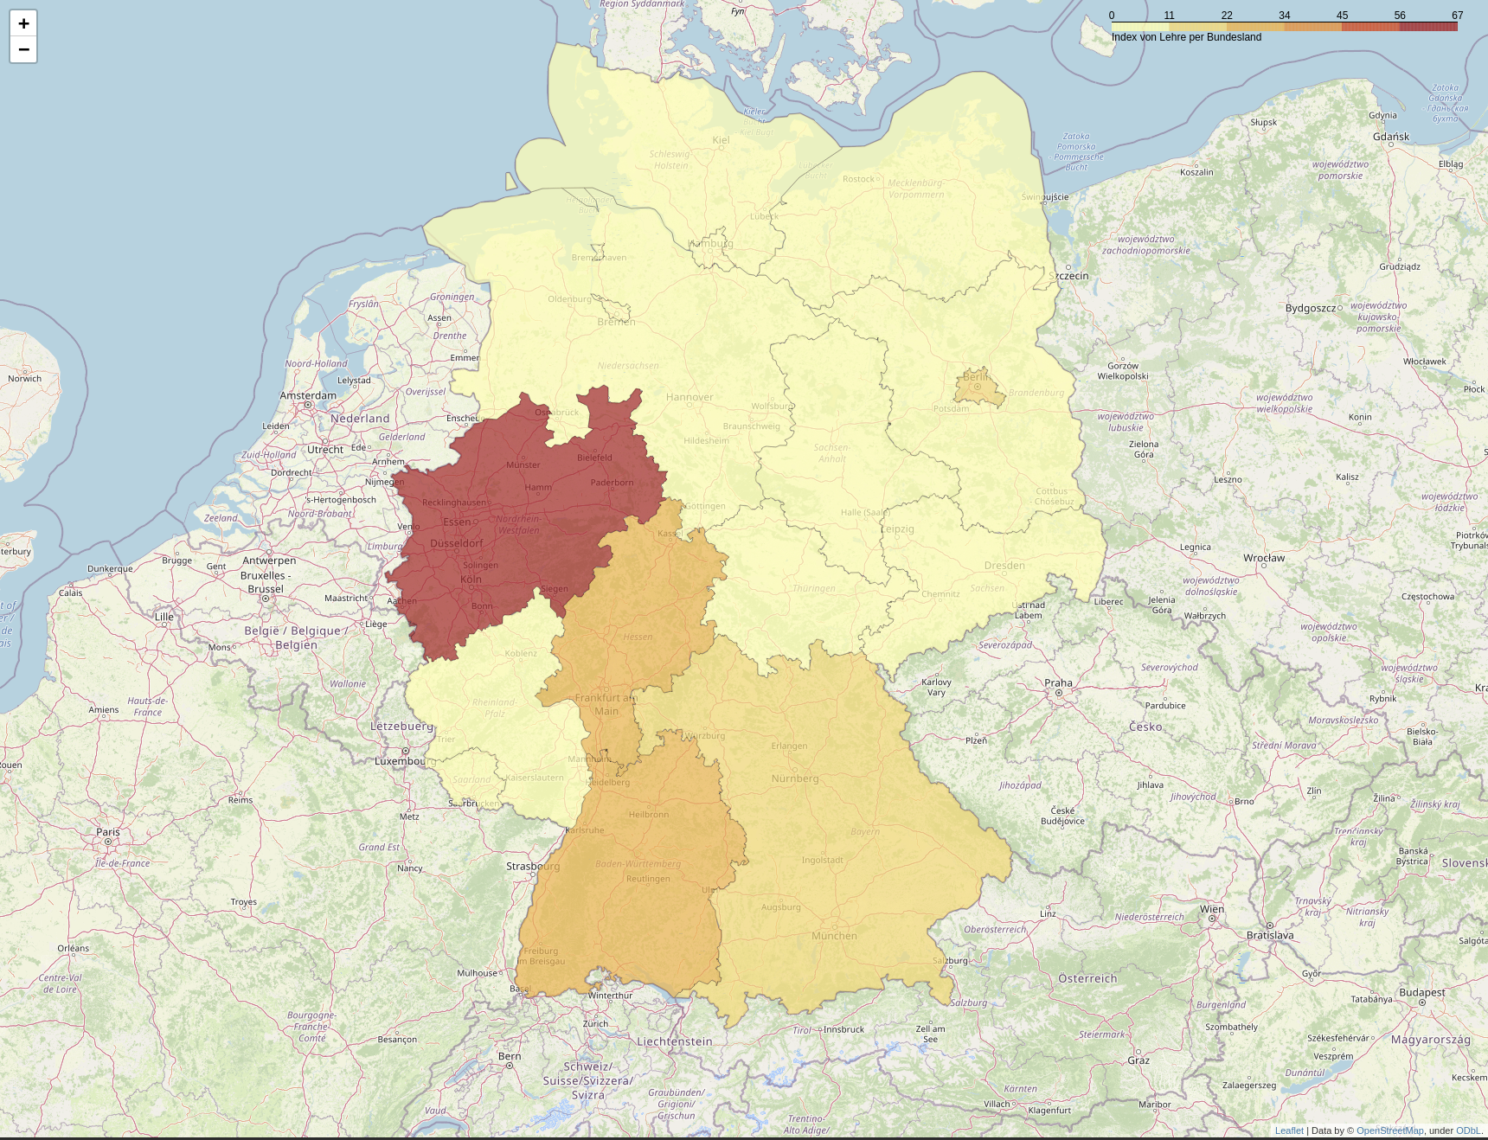
Result for amount of educational centres

Slide 9
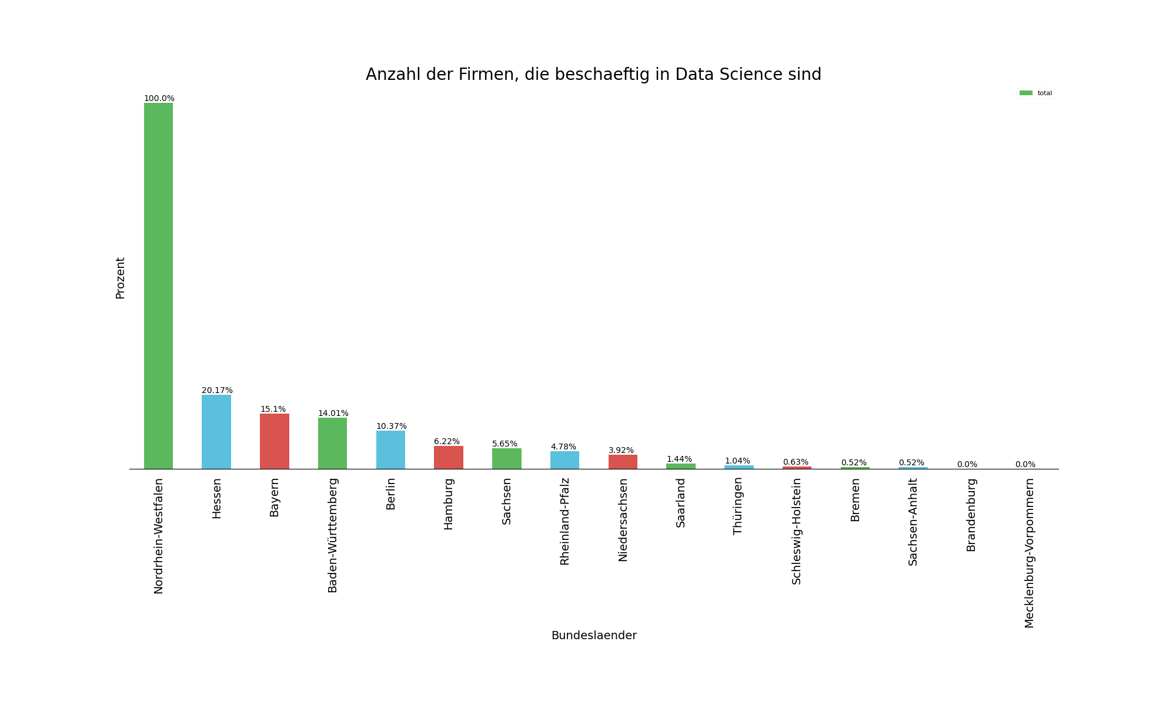
Graph per state for businesses

Slide 10
Graph per state for educational centres

Slide 11
Conclusion
The conclusion is that the most likely state in Germany for starting a career/ continue a career in DS is the west, and concrete in Nordrhein-Westfalen where the whole amount of businesses and education centres are.

Slide 12
Upcoming and further analysis
Further studies can be made and they are under development. These will be now enumerated:
It can be developed a progression on the time regards of the version date from which the Foursquare API’s call is made. With it, it is possible to predict where these clusters will move
This approaches can be made with research in data sources like rent-flat prices, etc.

